Slide 1

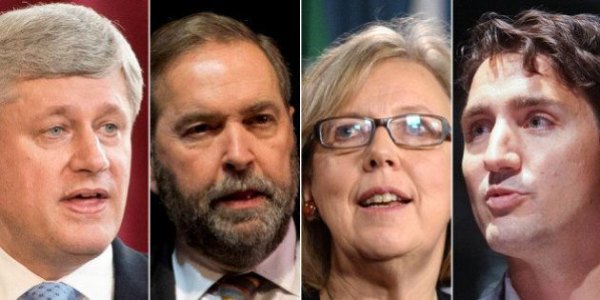
Canadian Federal Elections 2015
The data behind the vote
This Photo by Unknown Author is licensed under CC BY

Slide 2
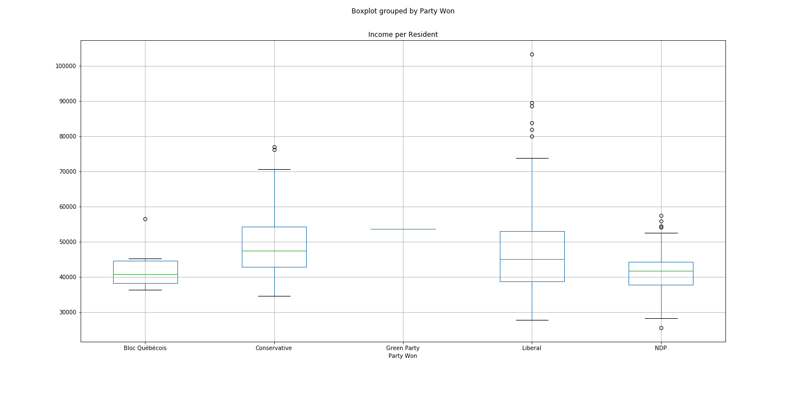
Income vs Votes by Federal Districts

Slide 3
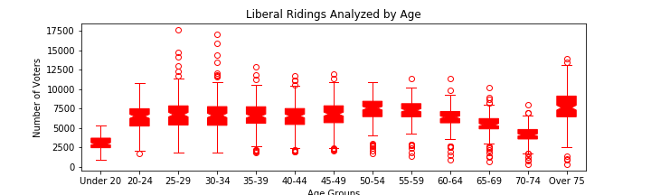
Liberal Voters

Slide 4
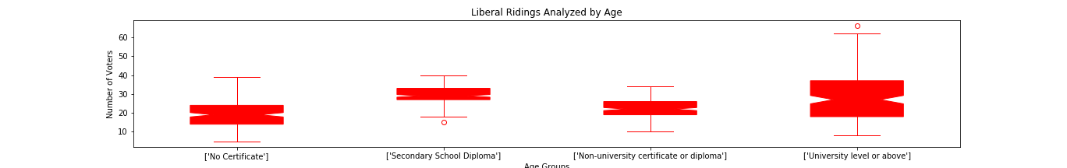
Liberal Voters

Slide 5
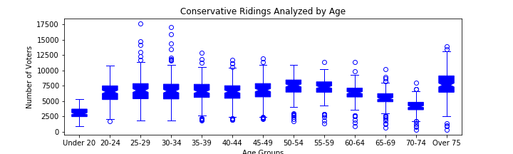
Conservative Voters

Slide 6
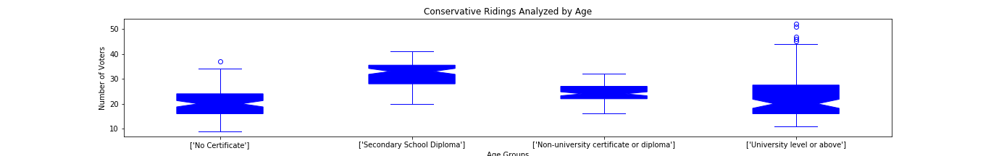
Conservative Voters

Slide 7
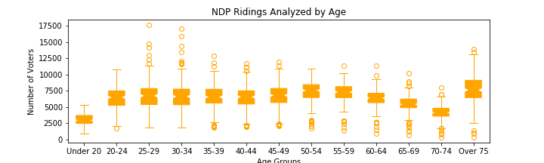
NDP Voters

Slide 8
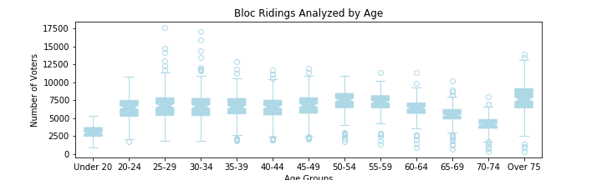
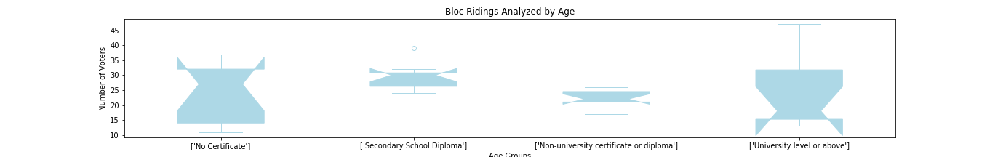
Bloc Votes

